Slide 1
Object Oriented Programming IT-1201
Dr. Jesmin Akhter
Associate Professor, IIT, JU

Slide 2
Java Swing

Slide 3
Introduction
Java Swing is a part of Java Foundation Classes (JFC) that is used to create window-based applications. It is built on the top of AWT (Abstract Windowing Toolkit) API and entirely written in java.
Unlike AWT, Java Swing provides platform-independent and lightweight components.
The javax.swing package provides classes for java swing API such as JButton, JTextField, JTextArea, JRadioButton, JCheckbox, JMenu, JColorChooser etc.

Slide 4
Introduction
What is JFC?
The Java Foundation Classes (JFC) are a set of GUI components which simplify the development of desktop applications.

Slide 5
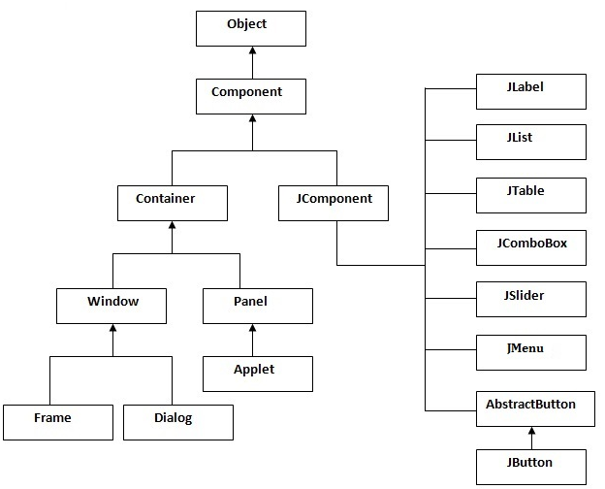
Hierarchy of Java Swing classes

Slide 6
Commonly used Methods of Component class
Method | Description
public void add(Component c) | add a component on another component.
public void setSize(int width,int height) | sets size of the component.
public void setLayout(LayoutManager m) | sets the layout manager for the component.
public void setVisible(boolean b) | sets the visibility of the component. It is by default false.

Slide 7
Java Swing Examples
There are two ways to create a frame:
By creating the object of Frame class (association)
By extending Frame class (inheritance)
We can write the code of swing inside the main(), constructor or any other method.

Slide 8
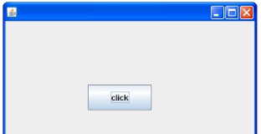
Simple Java Swing Example
import javax.swing.*;
public class FirstSwingExample {
public static void main(String[] args) {
JFrame f=new JFrame();//creating instance of JFrame
JButton b=new JButton("click");//creating instance of JButton
b.setBounds(130,100,100, 40);//x axis, y axis, width, height
f.add(b);//adding button in JFrame
f.setSize(400,500);//400 width and 500 height
f.setLayout(null);//using no layout managers
f.setVisible(true);//making the frame visible
}
}

Slide 9
Example of Swing by Association inside constructor
import javax.swing.*;
public class Simple {
JFrame f;
Simple(){
f=new JFrame();//creating instance of JFrame
JButton b=new JButton("click");//creating instance of JButton
b.setBounds(130,100,100, 40);
f.add(b);//adding button in JFrame
f.setSize(400,500);//400 width and 500 height
f.setLayout(null);//using no layout managers
f.setVisible(true);//making the frame visible
}
public static void main(String[] args) {
new Simple();
}
}
We can also write all the codes of creating JFrame, JButton and method call inside the java constructor.
The setBounds(int xaxis, int yaxis, int width, int height)is used in the above example that sets the position of the button.

Slide 10
Simple example of Swing by inheritance
import javax.swing.*;
public class Simple2 extends JFrame{//inheriting JFrame
JFrame f;
Simple2(){
JButton b=new JButton("click");//create button
b.setBounds(130,100,100, 40);
add(b);//adding button on frame
setSize(400,500);
setLayout(null);
setVisible(true);
}
public static void main(String[] args) {
new Simple2();
}}
We can also inherit the JFrame class, so there is no need to create the instance of JFrame class explicitly.

Slide 11
Java JButton
The JButton class is used to create a labeled button that has platform independent implementation. The application result in some action when the button is pushed. It inherits AbstractButton class.
Declaration:
public class JButton extends AbstractButton implements Accessible

Slide 12
Commonly used Constructors
Constructor | Description
JButton() | It creates a button with no text and icon.
JButton(String s) | It creates a button with the specified text.
JButton(Icon i) | It creates a button with the specified icon object.

Slide 13
Commonly used Methods of AbstractButton class
Methods | Description
void setText(String s) | It is used to set specified text on button
String getText() | It is used to return the text of the button.
void setEnabled(boolean b) | It is used to enable or disable the button.
void setIcon(Icon b) | It is used to set the specified Icon on the button.
Icon getIcon() | It is used to get the Icon of the button.
void setMnemonic(int a) | It is used to set the mnemonic on the button.
void addActionListener(ActionListener a) | It is used to add the action listener to this object.

Slide 14
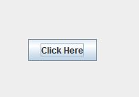
Java JButton Example
import javax.swing.*;
public class ButtonExample {
public static void main(String[] args) {
JFrame f=new JFrame("Button Example");
JButton b=new JButton("Click Here");
b.setBounds(50,100,95,30);
f.add(b);
f.setSize(400,400);
f.setLayout(null);
f.setVisible(true);
}
}

Slide 15

Example of displaying image on the button
import javax.swing.*;
public class ButtonExample{
ButtonExample(){
JFrame f=new JFrame("Button Example");
JButton b=new JButton(new ImageIcon("D:\\icon.png"));
b.setBounds(100,100,100, 40);
f.add(b);
f.setSize(300,400);
f.setLayout(null);
f.setVisible(true);
f.setDefaultCloseOperation(JFrame.EXIT_ON_CLOSE);
}
public static void main(String[] args) {
new ButtonExample();
}
}

Slide 16
Java JLabel
The object of JLabel class is a component for placing text in a container. It is used to display a single line of read only text. The text can be changed by an application but a user cannot edit it directly. It inherits JComponent class.
Declaration:
public class JLabel extends JComponent implements SwingConstants, Accessible

Slide 17
Commonly used Constructors
Constructor | Description
JLabel() | Creates a JLabel instance with no image and with an empty string for the title.
JLabel(String s) | Creates a JLabel instance with the specified text.
JLabel(Icon i) | Creates a JLabel instance with the specified image.
JLabel(String s, Icon i, int horizontalAlignment) | Creates a JLabel instance with the specified text, image, and horizontal alignment.

Slide 18
Commonly used Methods
Methods | Description
String getText() | t returns the text string that a label displays.
void setText(String text) | It defines the single line of text this component will display.
void setHorizontalAlignment(int alignment) | It sets the alignment of the label's contents along the X axis.
Icon getIcon() | It returns the graphic image that the label displays.
int getHorizontalAlignment() | It returns the alignment of the label's contents along the X axis.

Slide 19
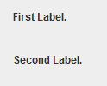
Java JLabel Example
import javax.swing.*;
class LabelExample
{
public static void main(String args[])
{
JFrame f= new JFrame("Label Example");
JLabel l1,l2;
l1=new JLabel("First Label.");
l1.setBounds(50,50, 100,30);
l2=new JLabel("Second Label.");
l2.setBounds(50,100, 100,30);
f.add(l1); f.add(l2);
f.setSize(300,300);
f.setLayout(null);
f.setVisible(true);
}
}

Slide 20
Java JLabel Example with ActionListener
import javax.swing.*;
import java.awt.*;
import java.awt.event.*;
public class LabelExample extends Frame implements ActionListener{
JTextField tf; JLabel l; JButton b;
LabelExample(){
tf=new JTextField();
tf.setBounds(50,50, 150,20);
l=new JLabel();
l.setBounds(50,100, 250,20);
b=new JButton("Find IP");
b.setBounds(50,150,95,30);
b.addActionListener(this);
add(b);add(tf);add(l);
setSize(400,400);
setLayout(null);
setVisible(true);
}

Slide 21
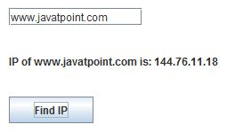
public void actionPerformed(ActionEvent e) {
try{
String host=tf.getText();
String ip=java.net.InetAddress.getByName(host).getHostAddress();
l.setText("IP of "+host+" is: "+ip);
}catch(Exception ex){System.out.println(ex);}
}
public static void main(String[] args) {
new LabelExample();
} }

Slide 22
Java Beans

Slide 23
JavaBean
A Java Bean is a software component that has been designed to be reusable in a variety of different environments.
There is no restriction on the capability of a Bean.
The JavaBeans architecture is based on a component model which enables developers to create software units called components.
Components are self-contained, reusable software units that can be visually assembled into composite components, applets, applications, and servlets using visual application builder tools.
JavaBean components are known as beans.
A bean encapsulates many objects into one object, so we can access this object from multiple places.

Slide 24
JavaBean
A JavaBean is a specially constructed Java class written in the Java and coded according to the JavaBeans API specifications.
A Java Bean is a java class that should follow following conventions:
It should have a no-argument constructor.
It should be Serializable.
It should provide methods to set and get the values of the properties, known as getter and setter methods.

Slide 25
Simple example of java bean class
//Employee.java
package mypack;
public class Employee implements java.io.Serializable{
private int id;
private String name;
public Employee(){}
public void setId(int id){this.id=id;}
public int getId(){return id;}
public void setName(String name){this.name=name;}
public String getName(){return name;}
}

Slide 26
How to access the java bean class?
To access the java bean class, we should use getter and setter methods.
package mypack;
public class Test{
public static void main(String args[]){
Employee e=new Employee();//object is created
e.setName("Arjun");//setting value to the object
System.out.println(e.getName());
}}
Note: There are two ways to provide values to the object, one way is by constructor and second is by setter method.

Slide 27
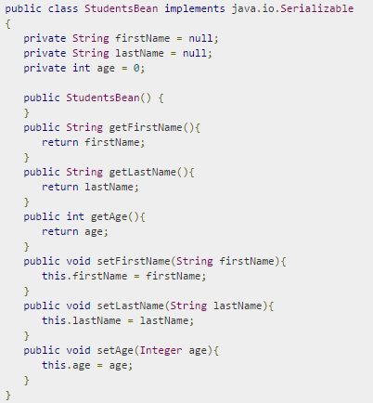
JavaBeans Example:

Slide 28
Java Database Connectivity (JDBC)

Slide 29
Database
A database is an integrated collection of data. There are many different strategies for organizing data to facilitate easy access and manipulation of the data.
A database management system (DBMS) provides mechanisms for storing and organizing data in a manner consistent with the database’s format.
Database management systems allow for the access and storage of data without worrying about the internal representation of databases.

Slide 30
Database
Most popular database systems are relational databases.
A language called Structured Query Language (SQL) is used almost universally with relational-database systems to perform queries (i.e., to request information that satisfies given criteria) and to manipulate data.
Some popular enterprise-level relational-database systems are Microsoft SQL Server, Oracle, Sybase, DB2, Informix and MySQL.

Slide 31
What is JDBC?
Java programs communicate with databases and manipulate their data using the Java Database Connectivity (JDBC) API.
JDBC stands for Java Database Connectivity, which is a standard Java API for database-independent connectivity between the Java programming language and a wide range of databases.

Slide 32
What is JDBC?
The JDBC library includes APIs for each of the tasks mentioned below that are commonly associated with database usage.
1) Making a connection to a database.
2) Creating SQL or MySQL statements.
3) Executing SQL or MySQL queries in the database.
4) Viewing & Modifying the resulting records.

Slide 33
Relational-Database Model
The relational-database model is a logical representation of data that allows the relationships between the data to be examined without consideration of the physical structure of the data.
A relational database is composed of tables.

Slide 34
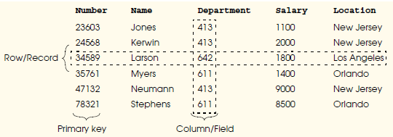
The table name is Employee

Slide 35
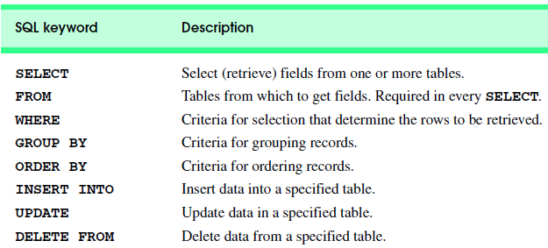
Structured Query Language (SQL)
SQL query keywords:

Slide 36
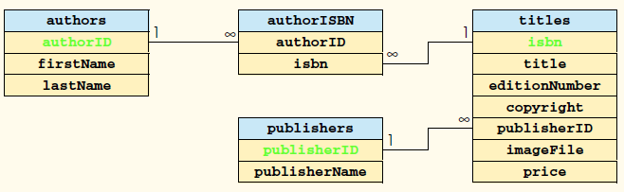
Consider the ‘books’ database (5 tables):

Slide 37
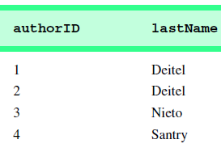
Basic SELECT Query
SELECT * FROM tableName
Consider the table: authors (authorID, firstName, lastName )
SELECT * FROM authors.
SELECT authorID, lastName FROM authors.
authorID and lastName from the authors table

Slide 38

WHERE Clause
In most cases, it is necessary to locate records in a database that satisfy certain selection criteria. Only records that match the selection criteria are selected.
SQL uses the optional WHERE clause in a SELECT query to specify the selection criteria for the query.
The simplest format of a SELECT query with selection criteria is:
Example:

Slide 39
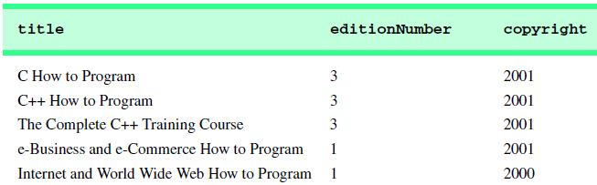
Output of previous query:

Slide 40
JDBC - Create Database Example
Example on how to create a Database using JDBC application.
Before executing the following example, make sure you have the following in place −
1) You should have admin privilege to create a database in the given schema. To execute the following example, you need to replace the username and password with your actual user name and password.
2) Your MySQL or whatever database you are using, is up and running.

Slide 41
5 Steps to connect to the database in java
The following steps are required to create a new Database using JDBC application −
Import the packages
Register the JDBC driver
Creating connection
Creating statement
Execute a query
Closing connection

Slide 42
5 Steps to connect to the database in java
1) Register the driver class:
Syntax of forName() method
public static void forName(String className)throws ClassNotFoundException.
2) Create the connection object:
The getConnection() method of DriverManager class is used to establish connection with the database.
Syntax of getConnection() method:
public static Connection getConnection(String url)throws SQLException.
public static Connection getConnection(String url,String name,String password) throws SQLException

Slide 43
5 Steps to connect to the database in java
3) Create the Statement object
The createStatement() method of Connection interface is used to create statement. The object of statement is responsible to execute queries with the database.
Syntax of createStatement() method:
public Statement createStatement()throws SQLException

Slide 44
5 Steps to connect to the database in java
4) Execute the query
The executeQuery() method of Statement interface is used to execute queries to the database. This method returns the object of ResultSet that can be used to get all the records of a table.
Syntax of executeQuery() method:
public ResultSet executeQuery(String sql)throws SQLException

Slide 45
5 Steps to connect to the database in java
5) Close the connection object
By closing connection object statement and ResultSet will be closed automatically. The close() method of Connection interface is used to close the connection.
Syntax of close() method:
public void close()throws SQLException

Slide 46
Creating database:
Connection conn = null;
Statement stmt = null;
System.out.println("Creating database...");
stmt = conn.createStatement();
String sql = "CREATE DATABASE STUDENTS"; stmt.executeUpdate(sql);
System.out.println("Database created successfully...");

Slide 47
Example to Connect Java Application with mysql database
For connecting java application with the mysql database, you need to follow 5 steps to perform database connectivity.
In this example we are using MySql as the database. So we need to know following information for the mysql database:
Driver class: The driver class for the mysql database is com.mysql.jdbc.Driver.
Connection URL: The connection URL for the mysql database is jdbc:mysql://localhost:3306/ict where jdbc is the API, mysql is the database, localhost is the server name on which mysql is running, we may also use IP address, 3306 is the port number and ict is the database name. We may use any database, in such case, you need to replace the ict with your database name.
Username: The default username for the mysql database is root.
Password: Password is given by the user at the time of installing the mysql database. In this example, we are going to use root as the password.

Slide 48
Example to Connect Java Application with mysql database
First create a table in the mysql database, but before creating table, we need to create database first.
create database ict;
use ict;
create table emp
(id int(10),
name varchar(40),
age int(3));

Slide 49
Example to Connect Java Application with mysql database
import java.sql.*;
class MysqlCon{
public static void main(String args[]){
try{
Class.forName("com.mysql.jdbc.Driver");
Connection con=DriverManager.getConnection(
"jdbc:mysql://localhost:3306/ict","root","root");
//here ict is database name, root is username and password
Statement stmt=con.createStatement();
ResultSet rs=stmt.executeQuery("select * from emp");
while(rs.next())
System.out.println(rs.getInt(1)+" "+rs.getString(2)+" "+rs.getString(3));
con.close();
}catch(Exception e){ System.out.println(e);}
}
}
Before doing this code add mysql jdbe driver library in library. If not found download it (3rd file, zip file) from mysql connector site

Slide 50
Creating table
Example on how to create a table using JDBC application :
System.out.println("Creating table in given database...");
stmt = conn.createStatement();
String sql = "CREATE TABLE REGISTRATION " +
"(id INTEGER not NULL, " + " first VARCHAR(255), " + " last VARCHAR(255), " +
" age INTEGER, " +
" PRIMARY KEY ( id ))";
stmt.executeUpdate(sql);
System.out.println("Created table in given database...");

Slide 51
JDBC - Insert Records Example
Example on how to insert records in a table using JDBC application.
System.out.println("Inserting records into the table...");
stmt = conn.createStatement();
String sql = "INSERT INTO Registration " +
"VALUES (100, 'Zara', 'Ali', 18)"; stmt.executeUpdate(sql);
sql = "INSERT INTO Registration " +
"VALUES (101, 'Mahnaz', 'Fatma', 25)"; stmt.executeUpdate(sql);
sql = "INSERT INTO Registration " +
"VALUES (102, 'Zaid', 'Khan', 30)";
stmt.executeUpdate(sql);
sql = "INSERT INTO Registration " +
"VALUES(103, 'Sumit', 'Mittal', 28)";
stmt.executeUpdate(sql);
System.out.println("Inserted records into the table...");

Slide 52
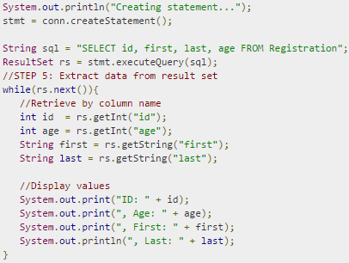
JDBC - Select Records Example
Complete code in Lab 8

Slide 53
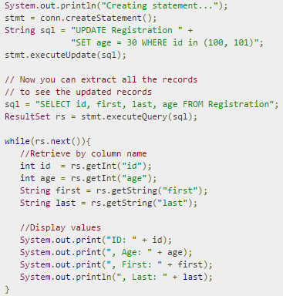
JDBC - Update Records Example

Slide 54

JDBC - Delete Records Example

Slide 55
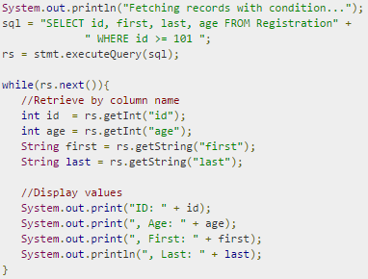
JDBC - WHERE Clause Example

Slide 56
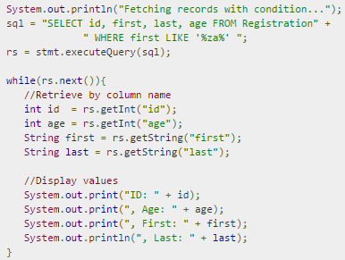
JDBC - Like Clause Example

Slide 57
What is a Servlet?
Servlet technology is used to create web application (resides at server side and generates dynamic web page).
Servlet technology is robust and scalable because of java language.
There are many interfaces and classes in the servlet API such as Servlet, GenericServlet, HttpServlet, ServletRequest, ServletResponse etc.

Slide 58
What is a Servlet?
Servlet can be described in many ways, depending on the context.
Servlet is a technology i.e. used to create web application.
Servlet is an API that provides many interfaces and classes including documentations.
Servlet is an interface that must be implemented for creating any servlet.
Servlet is a class that extend the capabilities of the servers and respond to the incoming request. It can respond to any type of requests.
Servlet is a web component that is deployed on the server to create dynamic web page.

Slide 59
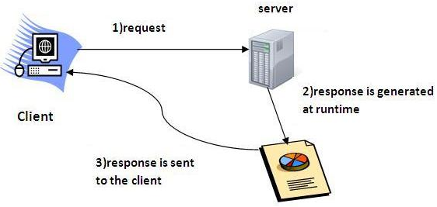
What is a Servlet?

Slide 60
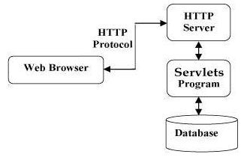
What is a Servlet?
Java Servlets are programs that run on a Web or Application server and act as a middle layer between a request coming from a Web browser or other HTTP client and databases or applications on the HTTP server.

Slide 61
Advantage of Servlet
The web container creates threads for handling the multiple requests to the servlet. Threads have a lot of benefits over the Processes such as they share a common memory area, lightweight, cost of communication between the threads are low. The basic benefits of servlet are as follows:
better performance: because it creates a thread for each request not process.
Portability: because it uses java language.
Robust: Servlets are managed by JVM so we don't need to worry about memory leak, garbage collection etc.
Secure: because it uses java language..

Slide 62
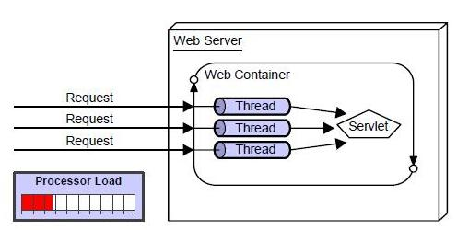
Advantage of Servlet

Slide 63
Servlet Terminology
The basic terminology used in servlet are given below:
HTTP
HTTP Request Types
Difference between Get and Post method
Container
Server and Difference between web server and application server
Content Type
Introduction of XML
Deployment

Slide 64
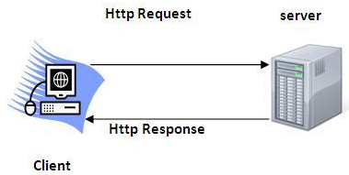
Servlet Terminology
HTTP (Hyper Text Transfer Protocol)
Http is the protocol that allows web servers and browsers to exchange data over the web.
It is a request response protocol.
Http uses reliable TCP connections by default on TCP port 80.

Slide 65
Servlet Terminology
Http Request Methods
Every request has a header that tells the status of the client. There are many request methods. Get and Post requests are mostly used.
The http request methods are:
GET
POST
HEAD
PUT
DELETE
OPTIONS
TRACE

Slide 66
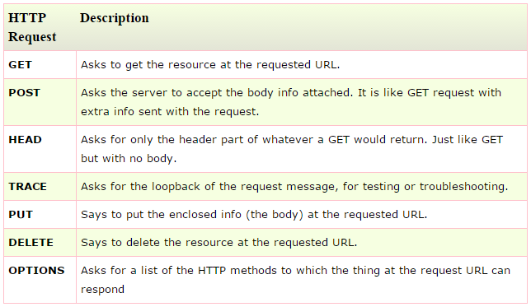
Servlet Terminology

Slide 67
Servlet Terminology
Container
It provides runtime environment for JavaEE (j2ee) applications.
It performs many operations that are given below:
Life Cycle Management
Multithreaded support
Object Pooling
Security etc.

Slide 68
Servlet Terminology
Server
It is a running program or software that provides services.
There are two types of servers:
Web Server: Example of Web Servers are: Apache Tomcat and Resin.
Application Server: Example of Application Servers are:
JBoss Open-source server from JBoss community.
Glassfish provided by Sun Microsystem. Now acquired by Oracle.
Weblogic provided by Oracle. It more secured.
Websphere provided by IBM.

Slide 69
Servlet Terminology
Content Type
Content Type is also known as MIME (Multipurpose internet Mail Extension) Type. It is a HTTP header that provides the description about what are you sending to the browser.
There are many content types:
text/html
text/plain
application/msword
application/vnd.ms-excel
application/jar
application/pdf
application/octet-stream
application/x-zip
images/jpeg
video/quicktime etc.

Slide 70
Servlets - Life Cycle
A servlet life cycle can be defined as the entire process from its creation till the destruction. The following are the paths followed by a servlet
The servlet is initialized by calling the init () method.
The servlet calls service() method to process a client's request.
The servlet is terminated by calling the destroy()method.
Finally, servlet is garbage collected by the garbage collector of the JVM.

Slide 71

Servlets - Life Cycle
The init() method :
The init() method is designed to be called only once. It is called when the servlet is first created, and not called again for each user request. So, it is used for one-time initializations.
The init() method simply creates or loads some data that will be used throughout the life of the servlet.
The init() method definition looks like this:

Slide 72

Servlets - Life Cycle
The service() method :
The service() method is the main method to perform the actual task.
The servlet container (i.e. web server) calls the service() method to handle requests coming from the client( browsers) and to write the formatted response back to the client.
Each time the server receives a request for a servlet, the server spawns a new thread and calls service. The service() method checks the HTTP request type (GET, POST, PUT, DELETE, etc.) and calls doGet, doPost, doPut, doDelete, etc. methods as appropriate.
The service() method definition looks like this:

Slide 73

Servlets - Life Cycle
The doGet() and doPost() are most frequently used methods with in each service request.
The doGet() Method
A GET request results from a normal request for a URL or from an HTML form that has no METHOD specified and it should be handled by doGet() method.

Slide 74

Servlets - Life Cycle
The doPost() Method
A POST request results from an HTML form that specifically lists POST as the METHOD and it should be handled by doPost() method.

Slide 75

Servlets - Life Cycle
The destroy() method :
The destroy() method is called only once at the end of the life cycle of a servlet. This method gives your servlet a chance to close database connections, halt background threads, write cookie lists or hit counts to disk, and perform other such cleanup activities.
After the destroy() method is called, the servlet object is marked for garbage collection. The destroy method definition looks like this:

Slide 76
Thank you

